Slide 1

SageSoulRAG: RAG-based Chatbot with Personality
Team 4
Aradhya Alva Rathnakar
Bhavan Kumar Basavaraju
Mahamaya Panda
ReddySaketh Reddy Chappidi
Shashi Kumar Kadari Mallikarjuna

Slide 2
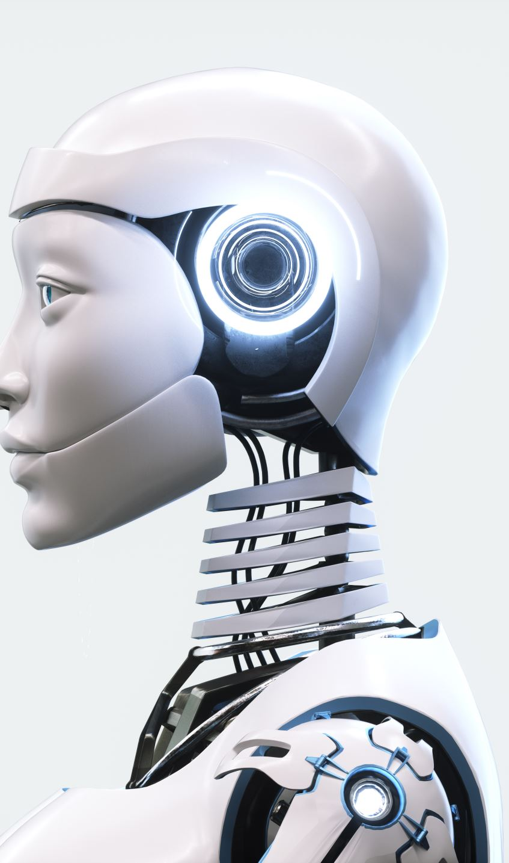
Project Background
Motivation:
Inspired by pervasive AI, this project develops RAG-based chatbot that personalize each interaction.
This chatbot stand as beacons of engagement and relatability in daily informative conversations.
Needs:
A need for continuous, context-aware responses in customer service, in the domains of finance and healthcare, to address the drawbacks of traditional rule-based chatbots.
Target Problem:
Overcoming the limitations of generic chatbot interactions by utilizing advanced LLMs to provide personalized and engaging responses that reflect human conversational nuances.
Impact:
Personalized chatbot interactions improve user experience across industries like customer service, education, healthcare, and entertainment.
This project advances natural language processing through innovative approaches to developing chatbots with unique personas.

Slide 3
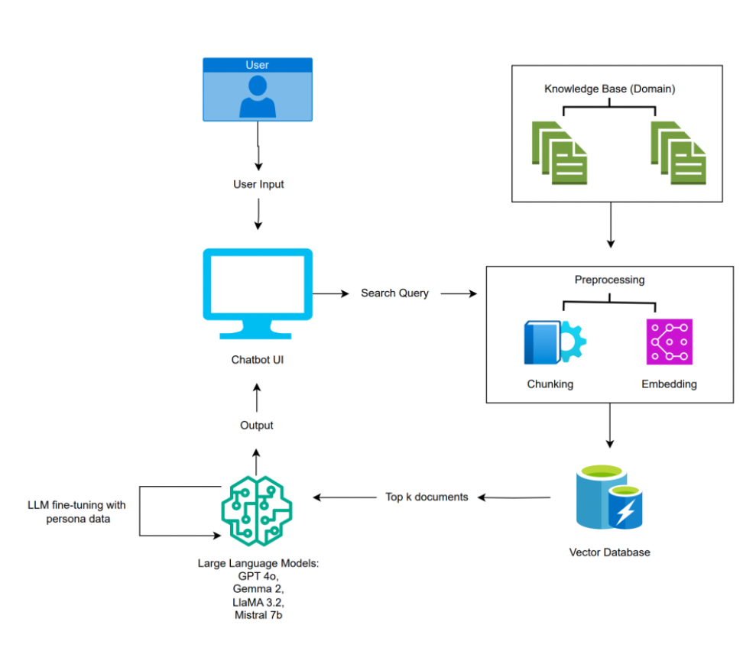
Executive Summary
Need for Chatbot RAG-based chatbot with Personality.
Source the Personality and Domain data from various websites and books.
Create RAG-based architecture where Pinecone is used as a knowledge base from where the chatbot can get the latest data based on the user's question.
Use Large Language Models (LLM) to generate human-like responses based on the data retrieved from the knowledge base.
Fine-tune LLMs (Gemma 2, GPT 4o, Mistral 7B, LlaMA 3.2) to respond to user queries based on the user's persona of choice
Compare performance using OpenAI Evals and DeepEvals to choose the best LLM for SageSoulRAG.

Slide 4
Technology and Solution Survey
Authors | Dataset | Models | Result | Conclusion
Roychowdhury et al. (2024) | Utilizes data from 3GPP and IEEE specifications, parsed using pydocx. | MPNET for source data embedding and the llama2-7b-chat model for generating answers | Improves retrieval approach using the Triplet Loss model and Masked Language Modeling | Acknowledges hardships in creating technical domain-specific chatbots and plans to explore custom parsing models for better handling tables and images.
Jiang et al. (2023) | Commonsense Reasoning, Mathematics, Code Generation, Various Benchmarks (Automated and Human) | Mistral 7B, Llama 2 (13B), Llama 1 (34B), Code-Llama 7B | Mistral 7B outperforms Llama 2 (13B) in all benchmarks, surpasses Llama 1 (34B) in reasoning, mathematics, code generation, and competes closely with Code-Llama 7B in coding tasks | Mistral 7B demonstrates superior reasoning, mathematical problem-solving, and code generation capabilities, outperforming larger models and showcasing high efficiency and adaptability across diverse NLP tasks.
Wei et al. (2023) | 374 dialogues collected from 48 participants interacting with a web-based chat interface. | Leverages GPT-3, DialoGPT, Llama 2, and BERT for chatbot development in Python. | Structured format with personality modifier performed best with an 83% slot filling rate. | Guides the development of chatbots with four LLM models for self-reported health data collection. Recommends using prompts as templates.
Nguyen et al. (2021) | Dataset with 50+ intents and 1500 examples related to NEU admission. | Rasa open-source framework for NEU-chatbot model. | Achieved 97.1% accuracy on the test set using precision, F1-score, and accuracy metrics. | Guides the implementation of a chatbot with personality traits using Python and training on large language models.
Bhate et al. (2023) | Real-world clinical notes annotated for demographics, social determinants, and family history. | GPT-3.5 model through OpenAI GPT-3.5 API. | High F1 on demographic information extraction (0.975), moderately high F1 on social determinant extraction (0.615), and family history extraction (0.722). | Future scope involves adapting GPT models to clinical NLP with less domain terminology and applying an active learning process. models.
Anil et al. (2023) | Diverse, multilingual dataset including web documents, books, code, and conversational data with extensive non-English data | PaLM 2, including various sizes (Small, Medium, Large) | Significant improvement across a range of tasks including language proficiency exams, reasoning, coding, and translation | PaLM 2 demonstrates state-of-the-art performance in language understanding and generation across multiple languages, offering improved inference efficiency and reduced bias compared to its predecessor.
Ham et al. (2020) | Delexicalized MultiWOZ dataset. | GPT-2 model combined with a database query module. | Success in the DSTC8 multi-domain dialogue system task. | Optimization of goal-oriented dialogue systems. Combines GPT-2 with a database query module for an end-to-end neural pipeline.
Zhang et al. (2019) | MultiWOZ dataset for task-oriented dialogue systems. | Multi-Action Data Augmentation (MADA) framework. | Improved task completion ability, information, and success rates. | Introduces MADA framework for addressing the one-to-many property in task-oriented dialogue systems. Utilizes DAMD network for context-to-response generation.

Slide 5
Literature Survey of Existing Research
Authors | Dataset | Models | Result | Conclusion
Ramjattan et al. (2021) | Survey data on financial literacy and user feedback. | Chatbot leveraging Nudge theory and gamification. Google's Dialog Flow service as the NLU platform. | 82% positive response from survey on the chatbot usefulness. Positive impact on financial decisions using Nudge theory and gamification | Highlights importance of chatbots in financial literacy. Utilizes Nudge theory and gamification for sound financial decisions. Envisions broader scenarios in financial literacy, loans, and investments.
Madotto et al. (2019) | Persona-chat dataset for meta-learning on personalized dialogue. | Persona-Agnostic Meta-Learning (PAML) approach extending Model-Agnostic Meta-Learning (MAML). | PAML outperforms non-meta-learning baselines in dialogue consistency and fluency. Achieves enhanced performance in both automatic and manual metrics. | Focuses on personalized dialogue agents using meta-learning approach. Demonstrates improved consistency and fluency with PAML.
Qian et al. (2018) | Weibo dataset with post-response pairs (9,697,651). Manual datasets for profile-related data. | Identity-Coherent Conversation Machine (ICCM) model with profile detector, bidirectional decoder, and position detector. Comparative models including general sequence-to-sequence models. | ICCM model outperforms baselines in naturalness, logic, and correctness. Human evaluations indicate superior responses. | Introduces ICCM model for identity-coherent conversation generation. Demonstrates superiority in generating more natural, logical, and correct responses.
Agarwal et al. (2023) | Evaluation using 100 questions across 20 categories in Odia language | ChatGPT (English LLM), OdiaGenAI (Odia-specific LLM) | ChatGPT: 76% correct answers with continuous prompting. OdiaGenAI: Lower accuracy with text-to-speech translation | Insights for developing a multilingual chatbot in Python. Understanding capabilities and limitations.
Chen et al. (2022) | Harry Potter Dialogue (HPD) dataset. | GPT-3, ChatGPT, Alpaca, ChatGLM (Character-aligned response). | ChatGPT achieved human-level matching on average of 76%. | Guidance for developing a chatbot with character personalities in Python.
Xie et al. (2019) | Chatbot training data from Quora sites. | Chatterbot (I&C Chat application). | Promising results with high average match rate (around 95%). | Utilizes Chatterbot for cryptocurrency-focused chatbot in Python.
Wang et al. (2023) | DailyDialog, PersonaChat | RNNs, LSTMs, BERT, GPT, BlenderBot3, ChatGPT | ChatGPT, and BlenderBot3 performed best on engagement and humane. | Identify suitable large language models (LLMs) like ChatGPT, implement them in Python with memory modules for consistency, and evaluate using automatic and human-based metrics.
Shuster et al. (2021) | Neural-retrieval in the loop architectures | RAG-Sequence, RAG-Token, FiD, BART | Models demonstrate state-of-the-art performance with improved knowledge grounding and reduced knowledge hallucination. | Investigates retriever-generator architectures and training schemes, incorporating diverse forms of knowledge beyond factual text. Addresses knowledge hallucination.
Parker et al. (2021) | College website-related queries | Feedforward Neural Network (NLP-based) | Successful creation of a chatbot using AI and NLP for students to get quick answers to queries from the college website. | Utilizes NLP and Feedforward Neural Network for chatbot creation to aid students.
Kulkarni et al. (2024) | In-house retrieval embedding models, ChatGPT | RAG-based model | GPT-4 model achieves 100% accuracy in responding to user queries based on FAQ data. | Utilizing LLMs and RL for optimizing response retrieval and generation in a chatbot.
Rackauckas et al. (2024) | Vector search, RAG, reciprocal rank fusion | RAG-Fusion | RAG-Fusion effectively generates relevant responses but faces challenges of longer computational time. | The study highlights the effectiveness of the RAG-Fusion approach in AI and NLP applications.
Anil et al. (2023) | Extensive, multilingual corpus including web documents, books, code, and conversational texts | PaLM 2 (Small, Medium, Large variants) | Marked improvements in language proficiency, reasoning, translation, and coding tasks across various languages | PaLM 2 achieves state-of-the-art performance, demonstrating significant multilingual capabilities and inference efficiency, with potential for future advancements in ethical AI applications.
Jiang et al. (2023) | Commonsense Reasoning, Mathematics, Code Generation, Various Automated and Human Benchmarks | Mistral 7B, Llama 2 (13B), Llama 1 (34B), Code-Llama 7B | Mistral 7B outperforms Llama 2 and Llama 1, competes closely with Code-Llama 7B | Mistral 7B demonstrates superior efficiency and adaptability, setting new benchmarks for performance in NLP tasks.

Slide 6
Project Resource Requirements
LLM | Hardware | Memory Configuration | Cost | Purpose
All LLMs | Chip - 8-core CPU with 4 performance cores and 4 efficiency cores | 8GB unified memory, 250GB SSD | Free | Data collection, cleaning, and Data Transformation of LLMs in Jupyter Lab
All LLMs | 8-core GPU | Configurable to 16GB, Configurable to 500GB SSD, 1TB, or 2TB SSD | Free: offered by University | Data collection, cleaning, Data Transformation, and fine-tuning of LLMs in Jupyter Lab
GPT 4o | Nvidia V100/A100 GPUs, Intel Xeon CPU, 1.5TB RAM | 175 billion parameters | Varies by size | Develop a chatbot with a personality using GPT-4o
PaLM 2 | Nvidia V100 GPU, Intel Xeon CPU, 16GB RAM | 92 million parameters | Varies by size | Develop a chatbot with personality using PaLM 2
LlaMA 3.2 | Nvidia V100 GPU, Intel Xeon CPU, 32GB RAM | 250 million parameters | Varies by size | Develop a chatbot with personality using LlaMA 3.2
Mistral 7B | Nvidia V100 GPU, Intel Xeon CPU, 16GB RAM | 109 million parameters | Varies by size | Develop a chatbot personality using Mistral 7B
Tools | Specifications | Cost | Purpose
BitBucket | Open Source | Free | Source and version control
Draw.io | Open Source | Free | WBS, PertChart, Figures
Jira | Tool | Free | Assigning Tasks, Gantt Chart
Zoom | Communication Pathway | Free | Project meetings
Google Docs | Open Source | Free | Documentation and Reporting
Google Colab | Open Source | Free | For Python Code
Jupyter Lab | Open Source through Anaconda | Free | For Python Code
GPU (Graphics Processing Units) Lab | Access from the college | Free | For Model development
Real-Time Finance and Medical Data API (RapidAPI) | Open Source | Free | Data Source for Real time Finance and Medical data
Hardware Requirements
Tools and Licenses
Database | Specification | Cost | Purpose
Pinecone Vector Database | Pinecone is a managed vector database designed for scalability and ease of integration with large language models. | Free | Serves as a foundational technology for building and deploying vector-based search applications, enabling fast and accurate similarity search at scale.
Database Requirements

Slide 7
Software Requirements
Software | Specifications | Cost | Purpose | Version
Python | Open Source | Free | Data Cleaning Data Preparation Data Analysis | 3.8
Pandas | Open Source | Free | Creating Dataframe | 1.3.2
Numpy | Open Source | Free | Dealing with Dataframe arrays | 3.2
NLTK | Open Source | Free | Data cleansing | 3.8.1
Transformer | GPT 4o | Input tokens:$0.003 /1k Tokens Output tokens:$0.004 /1k Tokens | It is capable of handling various language tasks with high quality and generating longer outputs | Latest
Embedding Model | cohere-embed-English-v3.0 | Free | It is used to convert words into vectors | Latest
TensorFlow | Open Source | Free | Large Language Model Building | 2.8
PyTorch | Open Source | Free | Large Language Model Building | 1.11
LLM | Lama Index | Free | It can be used for document indexing and retrieval | Latest
Streamlit | Open Source | Free | Streamlit for enhanced user interface | 1.2
API | Open Source | Free | It is used to send the query result to LLM | Latest
Docker | Open Source | Free | Containerizing LLM for easy deployment | 20.1
GPT 4o Tokenizer | Open Source | Free | Vital for text pre-processing in LLM | Latest
PyPDF2 | Open Source | Free | Used for reading PDF documents | 3.0.1
langchain | Open Source | Free | Framework for LLM application development | 0.1.14
textstat/textblob | Open Source | Free | Used to read the data from .txt files and manipulate it | Latest
AutoTokenizer, Seq2SeqTrainer | Open Source | Free | To tokenize input text efficiently for NLP tasks. To train sequence-to-sequence models effectively. | Latest
evaluate | Open Source | Free | Facilitates the assessment of model performance through various metrics and techniques. | Latest
transformers | Open Source | Free | To facilitate easy access to pre-trained models and enable fine-tuning for specific tasks. | Latest

Slide 8
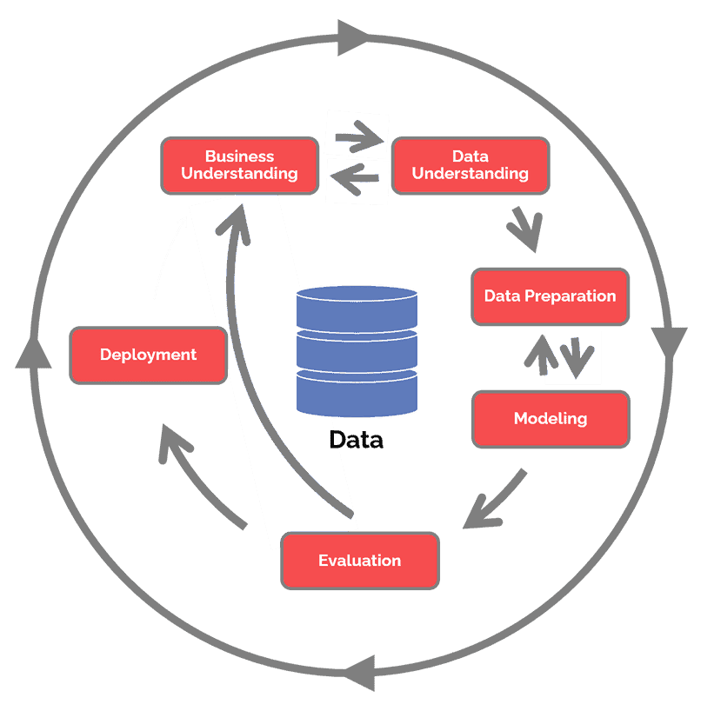
Project Development Methodology
CRISP – DM: Cross-Industry Standard Process for Data Mining

Slide 9
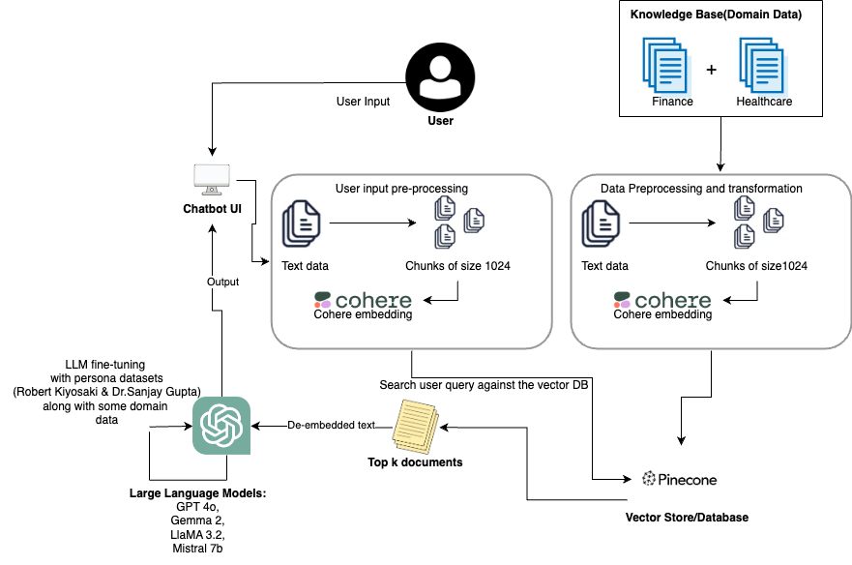
Project Architecture

Slide 10

Data Preparation

Slide 11

Data Collection
The Persona data for the project is gathered from
Persona Data -1 (Mr. Robert Kiyosaki):
Free online edition books written by Robert Kiyosaki like Rich Dad Poor Dad, and Cash Quadrant
Podcasts and video interview transcripts featuring Robert Kiyosaki using tools like app.podscribe.com
Persona Data -2 (Dr. Sanjay Gupta):
Free online edition books written by Sanjay Gupta like Keep Sharp: Build a Better Brain at Any Age, and Chasing Life: New Discoveries in the Search for Immortality.
Podcasts and video interview transcripts featuring Dr. Sanjay Gupta using tools like app.podscribe.com

Slide 12
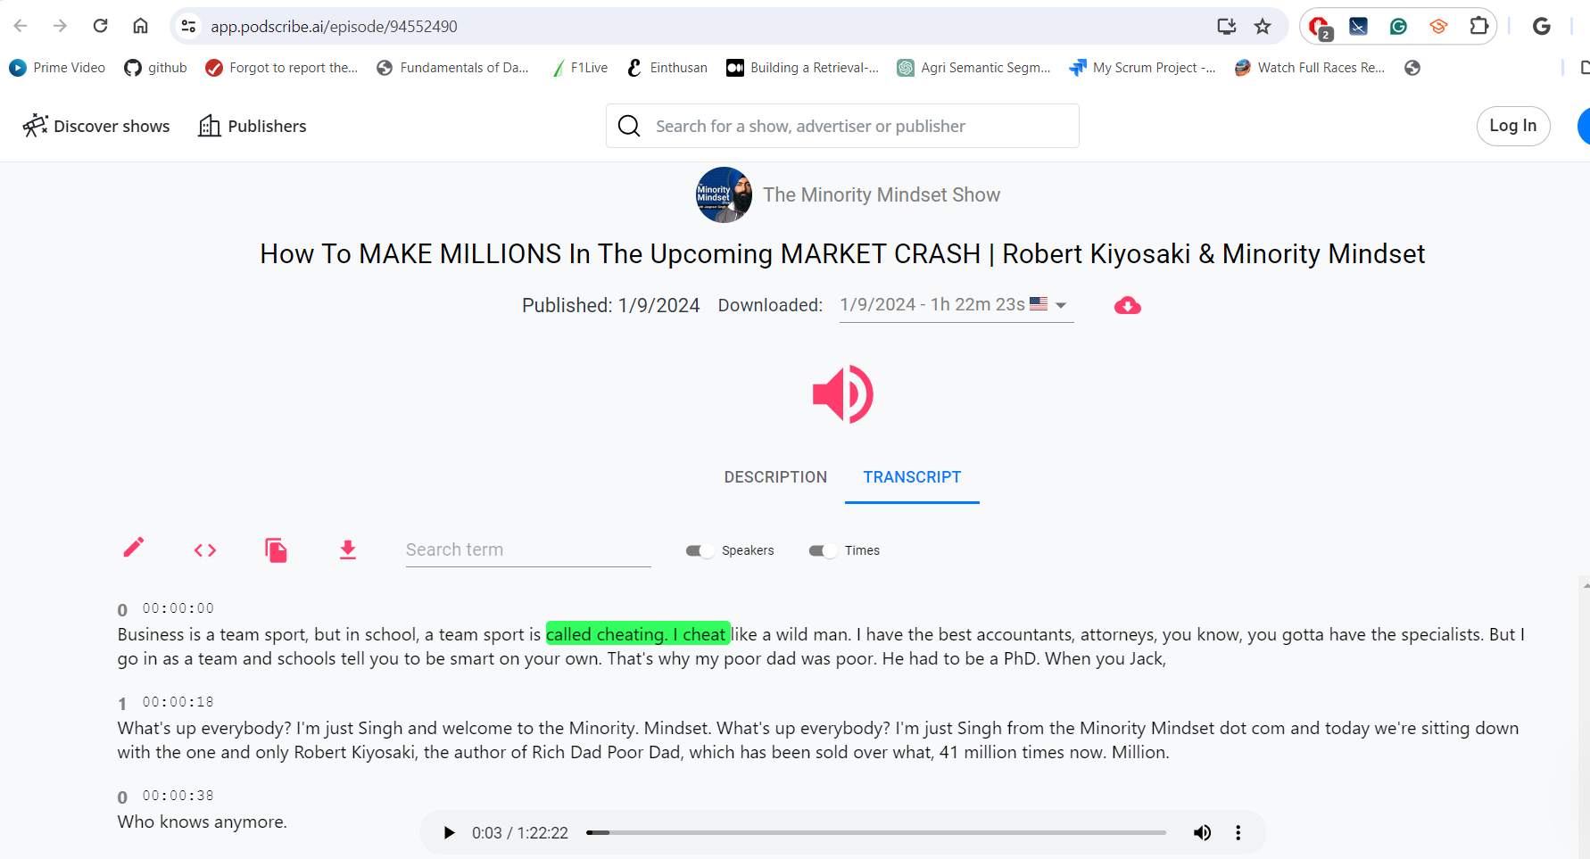

Data Collection: Persona
Free Online Edition books:
Downloaded from multiple sources like Internet Archieve
Podcast transcripts:
app.podscribe.com

Slide 13

Data Collection
Domain -1 (Finance):
Books by the US Treasury Department
Publications by the Securities and Exchange Commission (SEC)
RapidAPI – Real-Time Finance Data
Domain -2 (Healthcare):
McGraw Hill's book on Medicine
RapidAPI - EndlessMedicalAPI

Slide 14
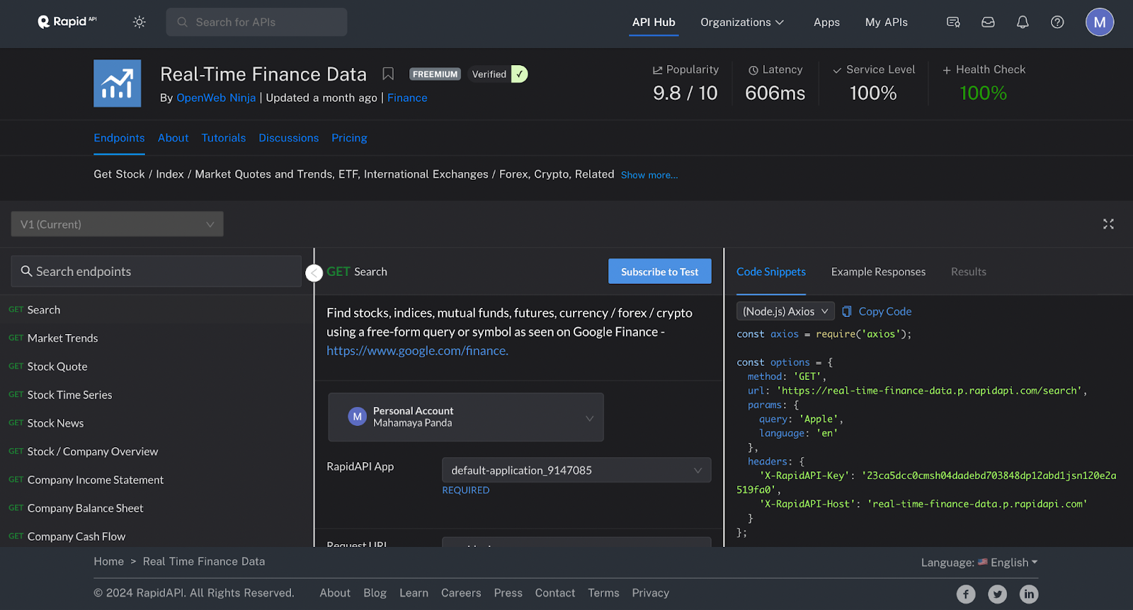
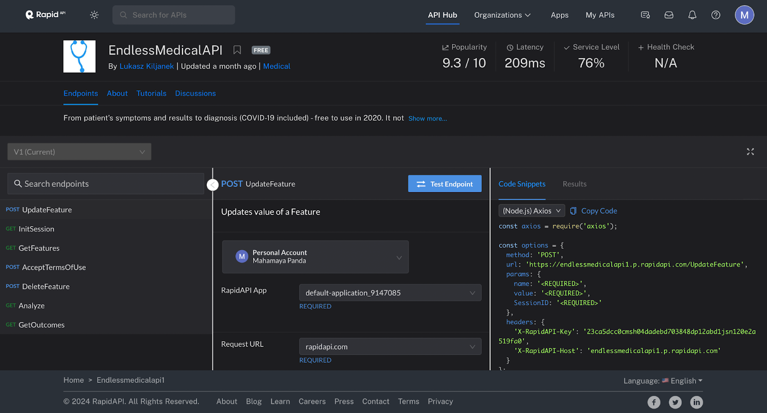
Data Collection: Domain
Domain Articles:
Downloaded from multiple online sources like Bloomberg, sec websites
RapidAPI:
Real-Time Finance Data API and EndlessMedicalAPI

Slide 15
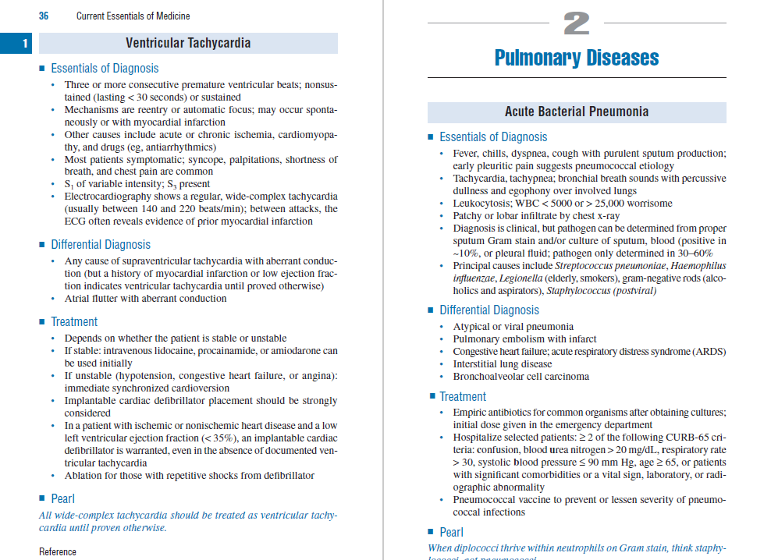
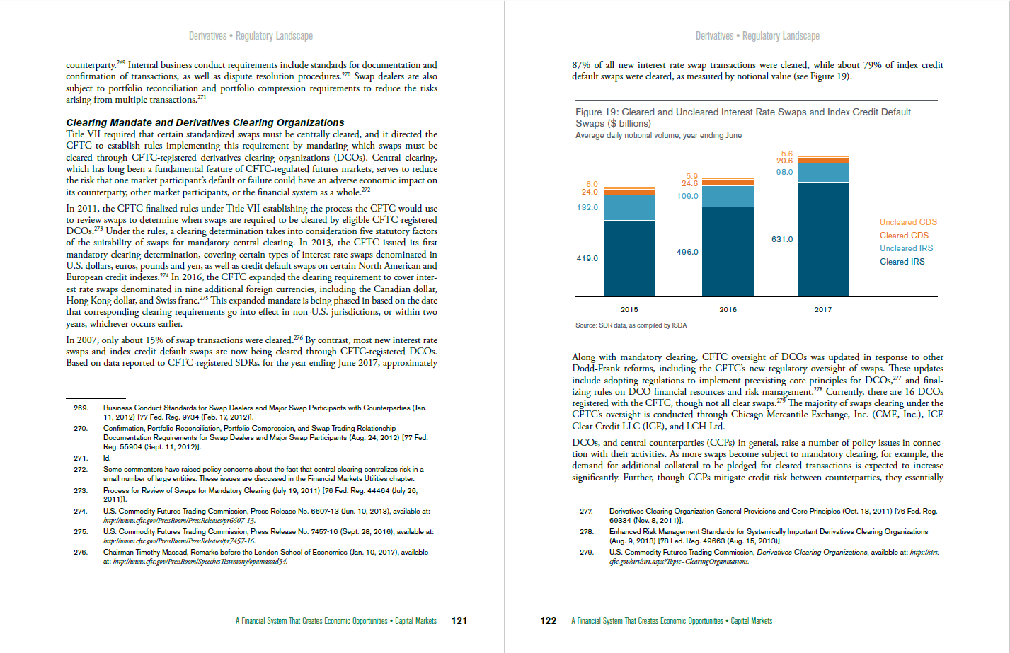
Data Preprocessing: Raw Samples: Domain
The figure above shows a sample from the financial system capital markets book
The figure above shows a sample from the current Essentials of Medicine book

Slide 16
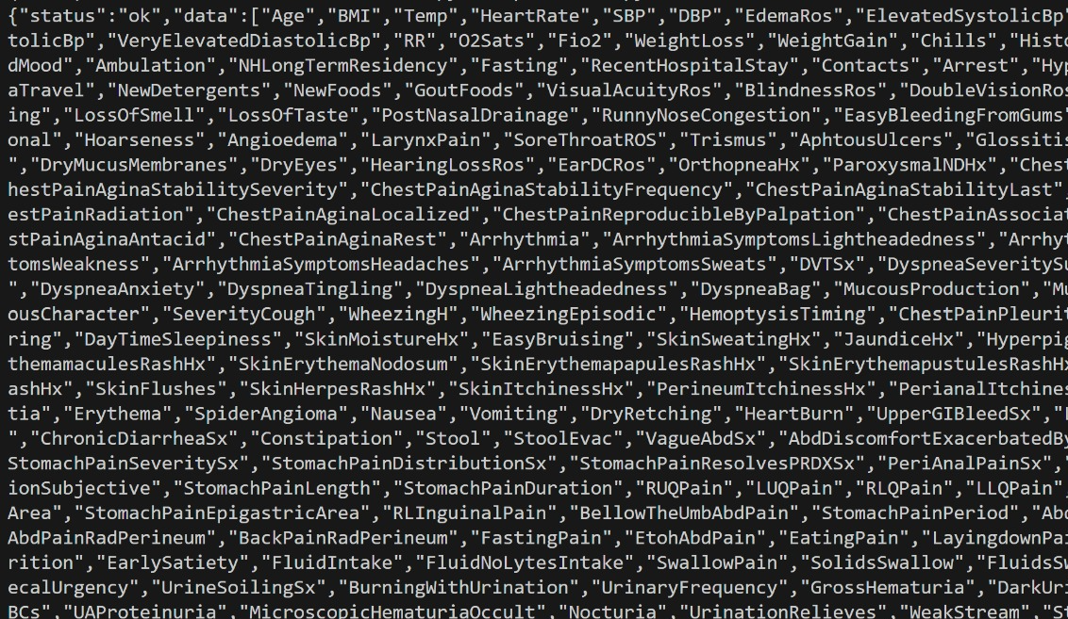
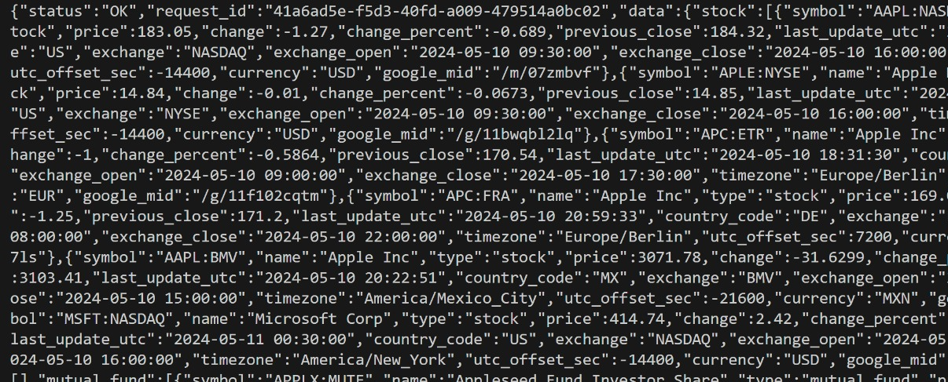
Data Preprocessing: Raw Samples: RapidAPI Domain Data
The figure above shows a sample from real-time financial data API.
The figure above shows a sample from real-time medical data API.

Slide 17
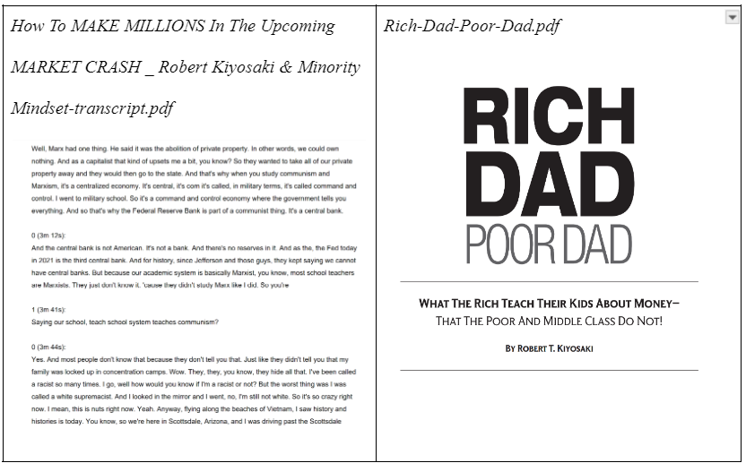
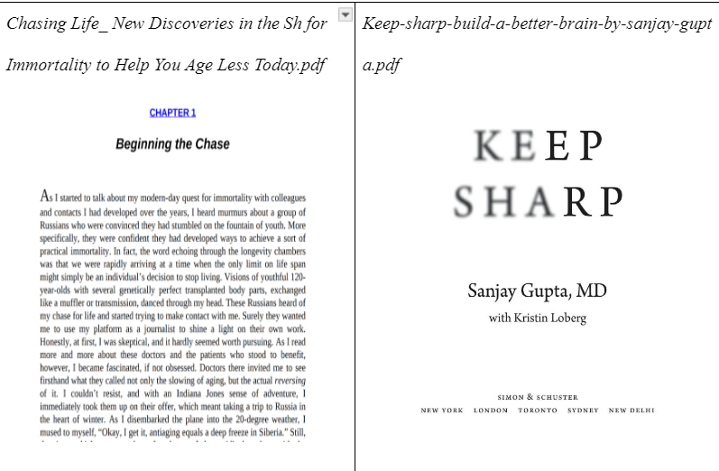
Data Preprocessing: Raw Samples: Persona
The figure above shows a sample data for Mr. Robert Kiyosaki
The figure above shows a sample data for Dr. Sanjay Gupta

Slide 18
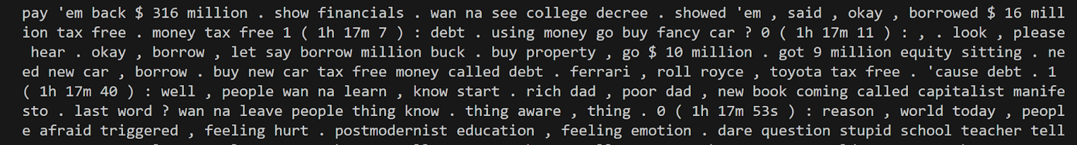
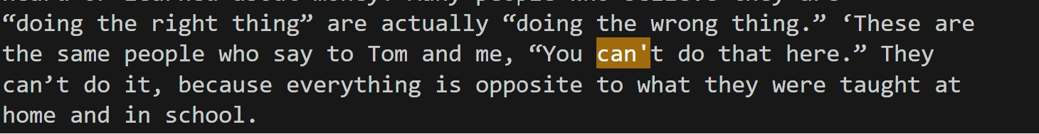
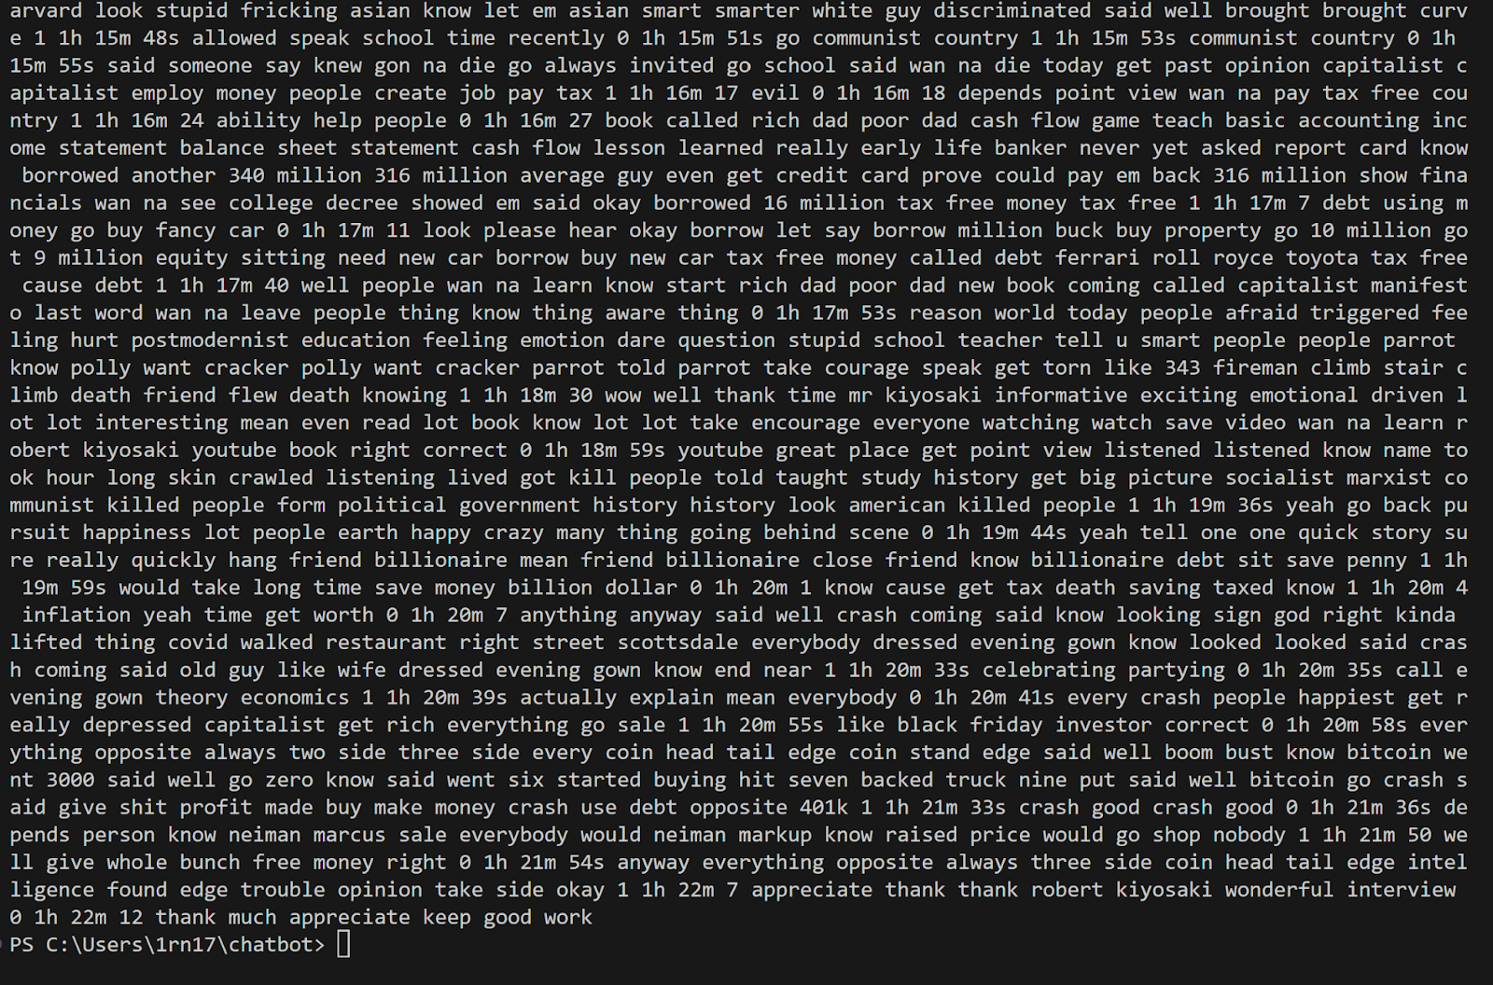
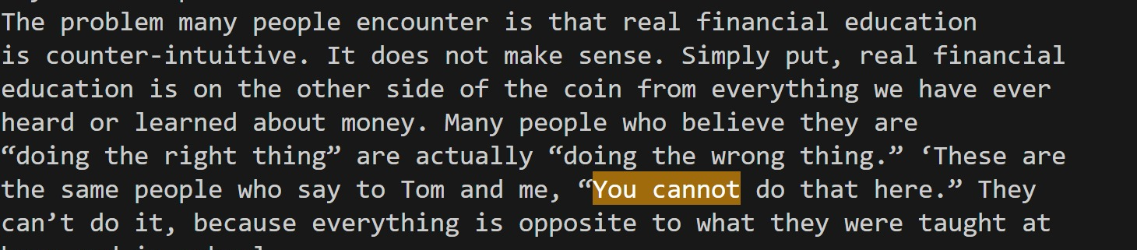
Data Preprocessing: Text Normalization
1. Replace word contractions with full forms.
2. Handle URLs, special characters, punctuations
Before Text Normalization
After Text Normalization

Slide 19
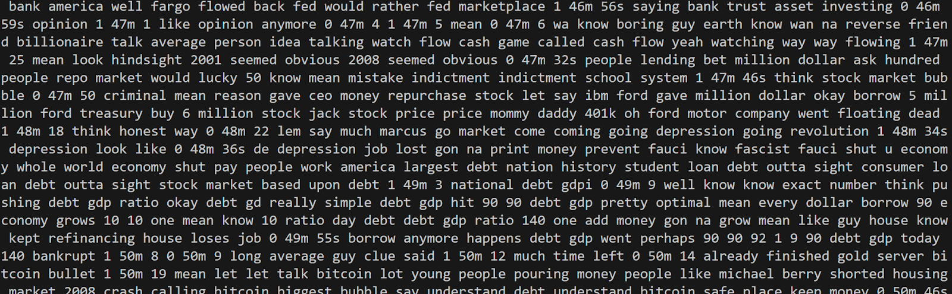
Data Preprocessing: Text Normalization
3. Removal of extra white spaces. 4. Lemmatization (breaks down words into their root form to identify similarities) is performed.

Slide 20
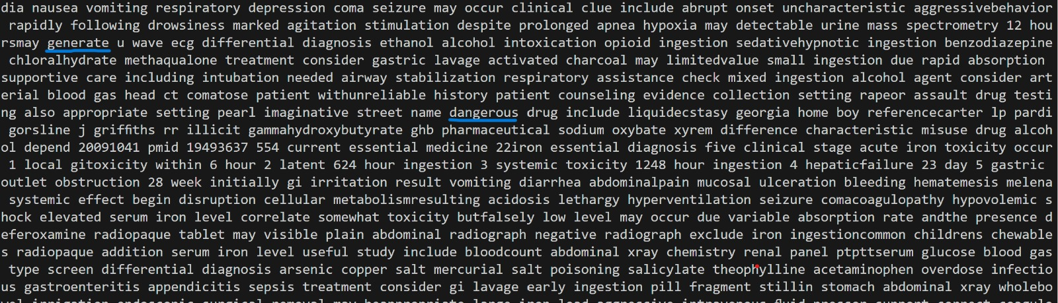
Data Preprocessing: Data Augmentation
Synonym replacement: Helps to bring in variability in vocabulary.
Back Translation: Useful to ensure semantic consistency, robustness, and provides linguistic flexibility.

Slide 21
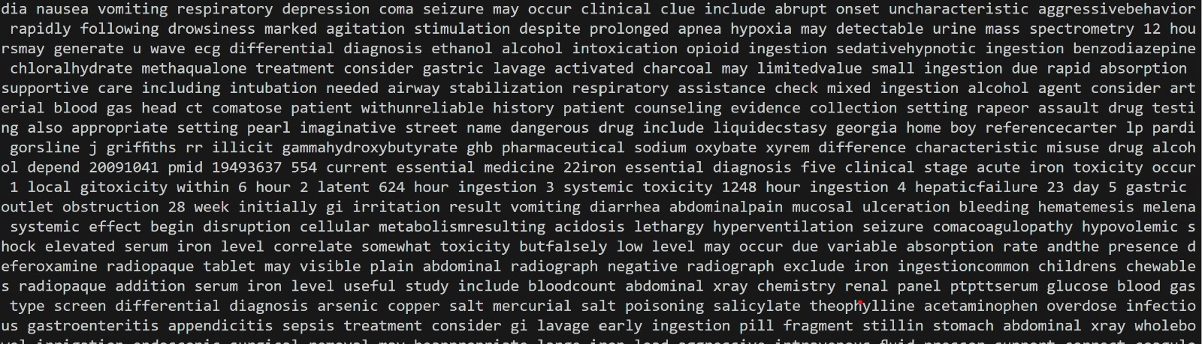
Data Preprocessing: Data Augmentation
3. Text generation using GPT 2 to increase the textual data – Beneficial for training models to generate coherent and contextually relevant text over longer sequences.

Slide 22
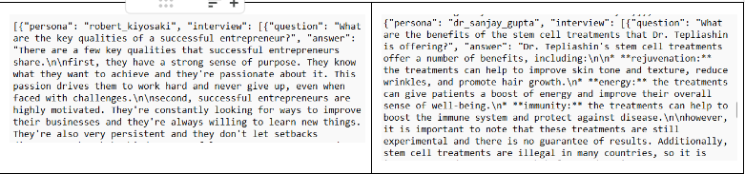
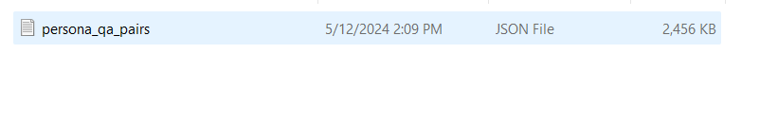
Data Transformation:
Q-A pair generation using Persona Data
Usage of PaLM 2 model for question answer pair generation.
QA pairs saved in .json format to be used for fine-tuning LLMs

Slide 23
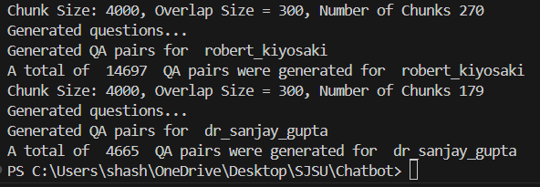
Data Transformation: Q-A pair generation using Persona Data

Slide 24

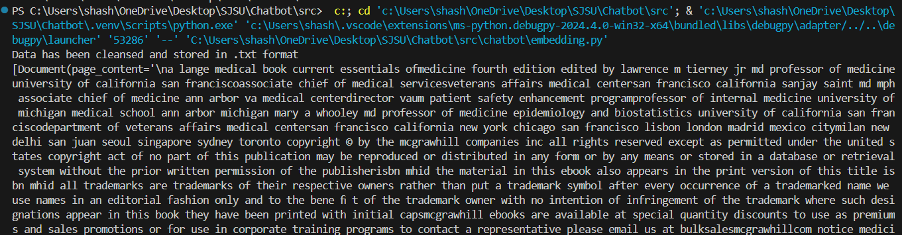
Data Transformation
Clean data stored in .txt format
Reading the .txt file as a document for transformation

Slide 25
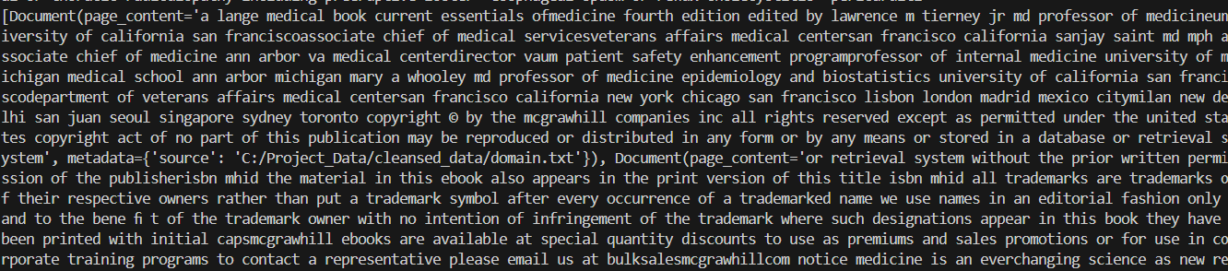
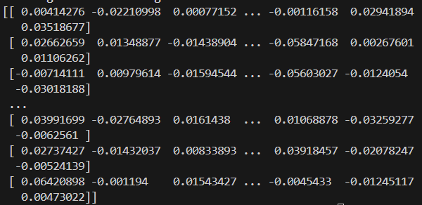
Data Transformation
Chunking input data into 1024 characters with 24 characters overlap which is requirement for Cohere embedding model.
Vector embedding which is a result of cohere embedding(context aware representation of data)

Slide 26
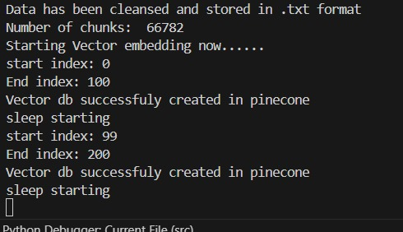
Data Transformation
Chucking process resulted in 66,782 chunks.
Storing the embedded text in Pinecone database

Slide 27
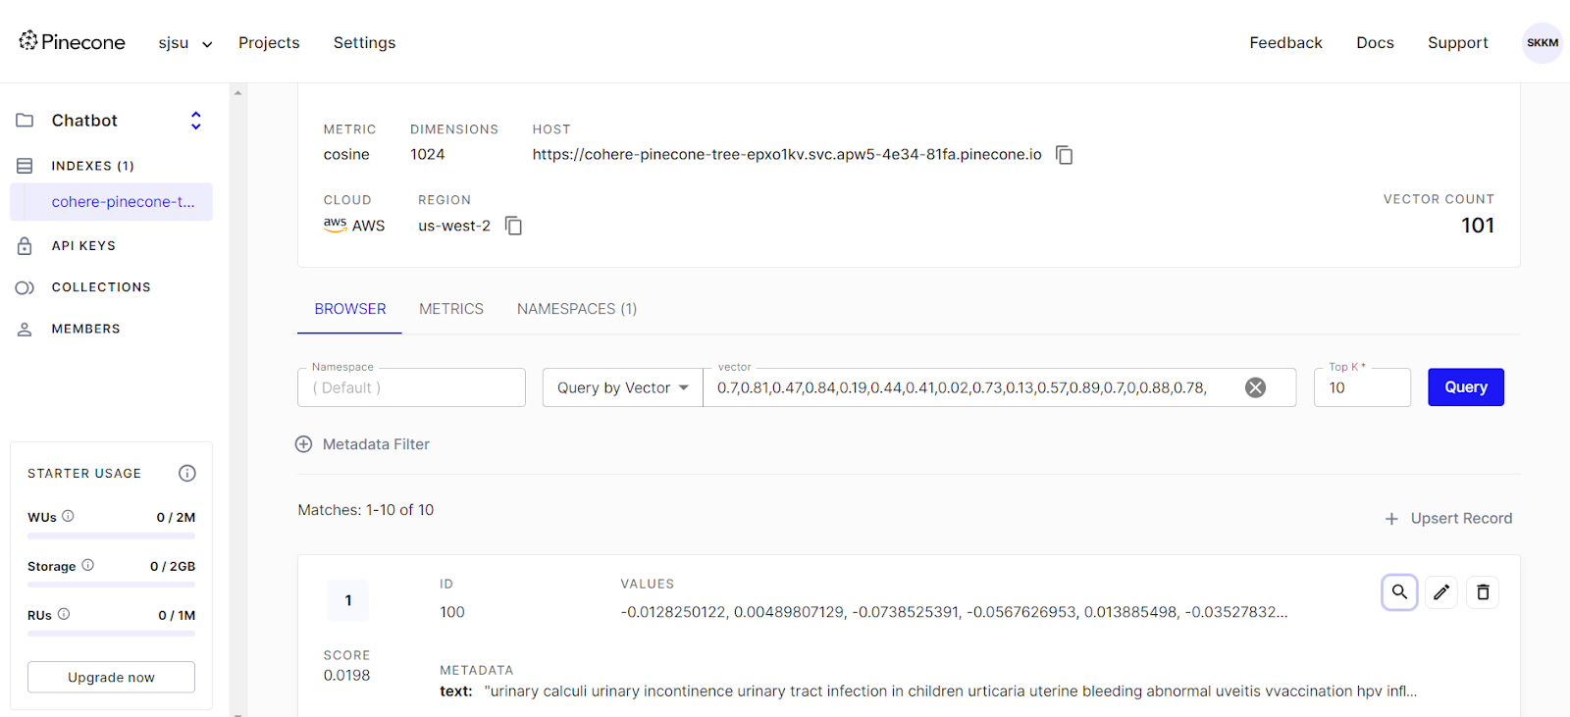
Data Transformation
Pinecone database that is hosted on AWS.

Slide 28
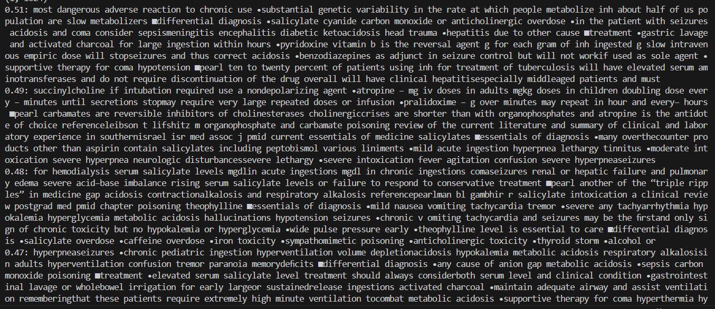
Data Transformation
Top 5 matches from the vector database for question: What is the treatment for Salicylates?

Slide 29
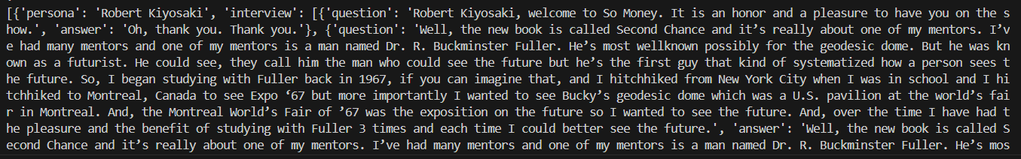
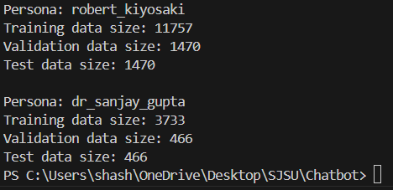
Data Preparation
Persona data in QA format.
Split of persona data for LLM fine-tuning which are in QA format in the ratio of 80:10:10 for training, validation, and testing.

Slide 30
Data Statistics
Stage | Dataset | Number of Files
Raw Data Source | Finance Domain | 7 pdf files + RapidAPI
 | Healthcare Domain | 1 pdf files + RapidAPI
 | Mr. Robert Kiyosaki Persona Dr. Sanjay Gupta Persona | 5 pdf files + Podcast transcripts 2 pdf files + Podcast transcripts
Data Pre-processing | Domain | 1 txt file
 | Persona | 1 txt file
Data Transformation | Data stored in Pinecone database as (id, vector, meta-data) | 66,782 records each with 1024 vectors
Data Preparation | Training dataset for Mr. Robert Kiyosaki Training dataset for Dr. Sanjay Gupta Validation dataset for Mr. Robert Kiyosaki Validation dataset for Dr. Sanjay Gupta Test dataset for Mr. Robert Kiyosaki Test dataset for Dr. Sanjay Gupta | 11,757 question-answer pairs 3,733 question-answer pairs 1,470 question-answer pairs 466 question-answer pairs 1,470 question-answer pairs 466 question-answer pairs

Slide 31
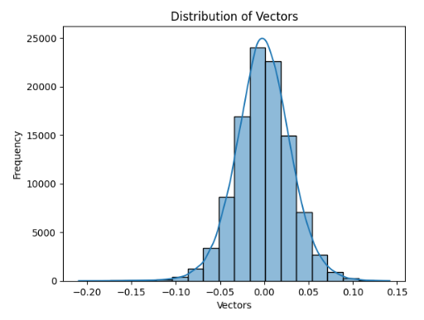
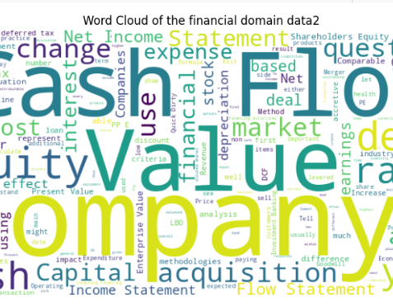
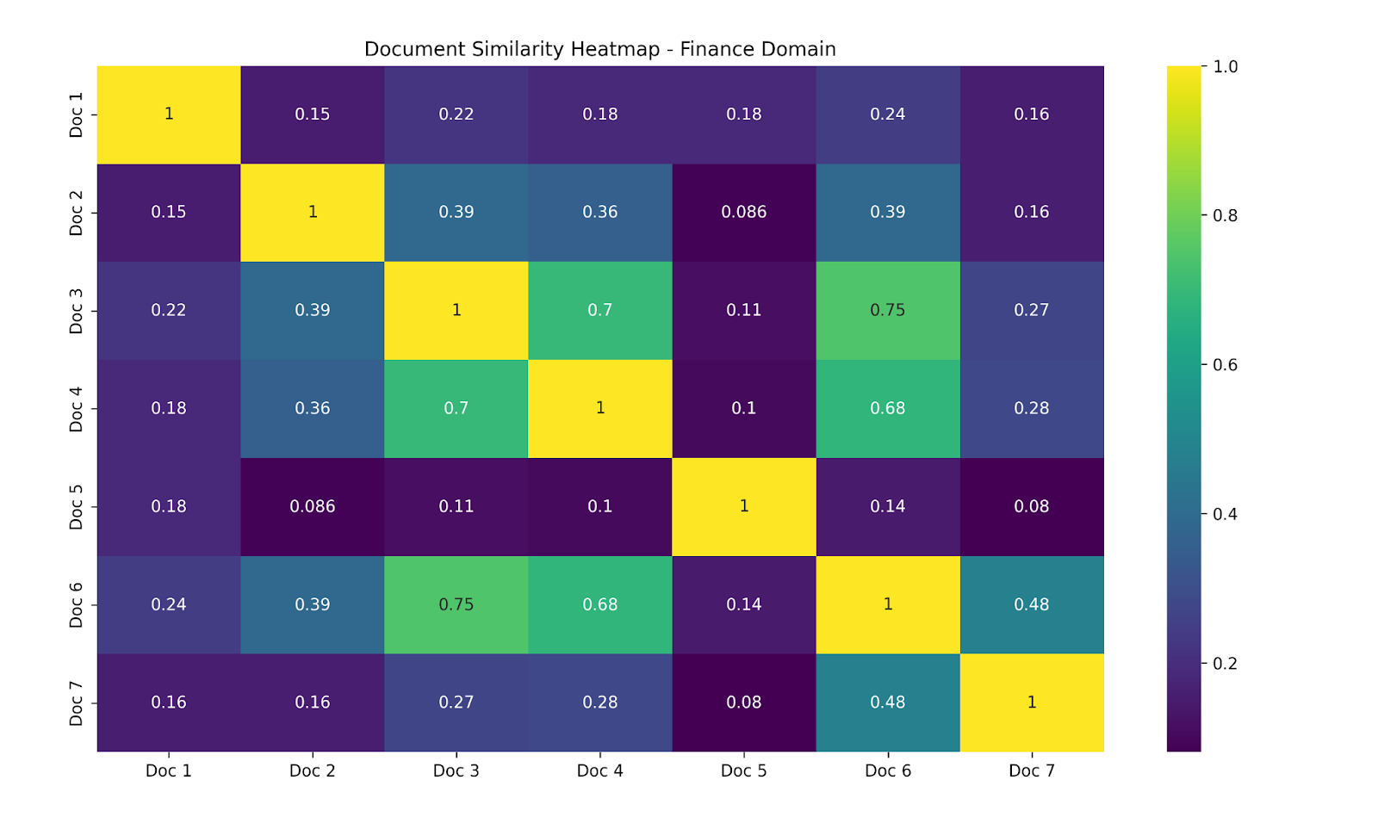
Data Statistics
The histogram indicates that the data in the Pinecone vector database is uniformly distributed and normalized, with vector values mainly concentrated around zero, ranging from approximately -0.20 to 0.15.
The heatmap visualizes document similarity in the finance domain, with Doc 3 and Doc 6 showing the highest similarity at 0.75.
The word cloud distills key investment banking concepts into a concise visual reference, aiding comprehension and application in the finance industry.

Slide 32
Model Development
Model Proposals
Model Supports
Model Comparison and Justification
Model Evaluation Methods

Slide 33
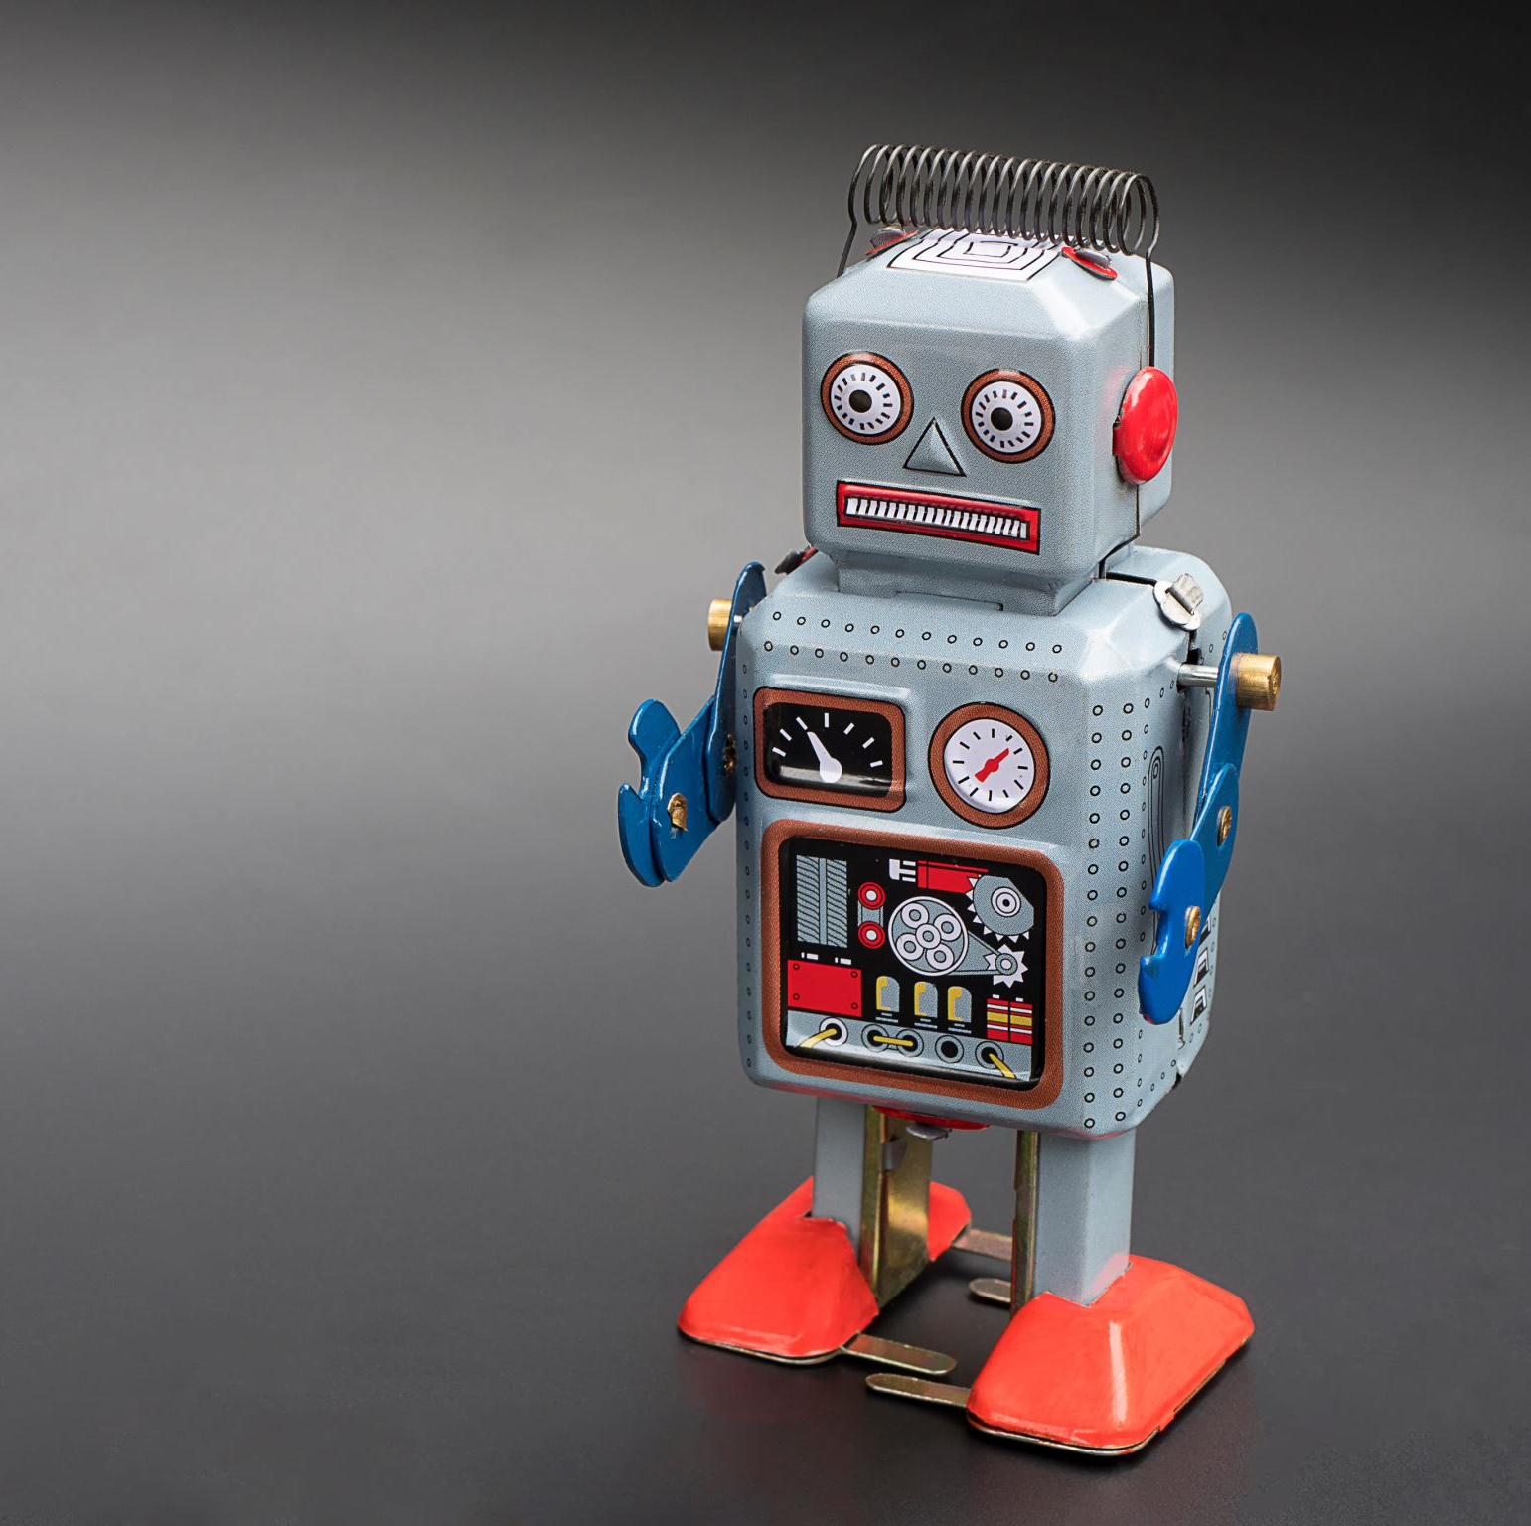
Model Proposals
The project utilizes four large language models:
GPT 4o (Generative Pre-trained Transformer)
LlaMA 3.2 (Large Language Model Meta AI 2)
Gemma 2
Mistral 7B (Mistral 7 Billion Parameters)

Slide 34
Model Comparison and Justification
Features | GPT 4o | Mistral 7B | Llama 3.2 | Gemma 2
Model Type | Autoregressive Transformer Language Model | Transformer-based Language Model | Transformer-based Language Model | Transformer-based Language Model
Application | Text Generation, Comprehension, Summarization | Text generation, language modeling, language understanding | Language Model Pre-training, Text Generation | Text generation, language understanding, complex reasoning
Pre-training Data | Broad and diverse internet text | Web-scale text | Web-scale text | Extremely large and diverse dataset
Fine-tuning Data | Depends on application | Can be tailored to specific applications using relevant datasets | Depends on application | Adaptable through fine-tuning on specialized datasets
Input Encoding | Tokenized text | Tokenized text | Tokenized text | Tokenized text
Output Encoding | Probability distribution over vocabulary tokens | Probability distribution over vocabulary tokens | Probability distribution over vocabulary tokens | Probability distribution over vocabulary tokens
Bidirectionality | Unidirectional (left-to-right) | Bidirectional | Bidirectional | Unidirectional in generation tasks but can utilize bidirectional contexts in understanding tasks
Maximum Context | Context window determined by the token limit | Larger context window than traditional models like BERT, but typically less than GPT-3.5 | Larger context window than BERT | Extensive context window, generally larger than most transformer models
Parameters | Extremely large (billions of parameters) | Large, with hundreds of millions of parameters | Large (hundreds of millions of parameters) | Extremely large (billions of parameters)
Architecture | Transformer with variations (GPT) | Transformer with optimizations for better handling of different lengths of context | Transformer with variations (LLAMAs) | Advanced transformer architecture with modifications for handling complex reasoning and larger context windows
Training Time | Weeks to months | Requires weeks to months | Weeks to months | Extensive, often spanning several months
Space Complexity | Extremely large (hundreds of GBs) | Very large (tens of GBs) | Very large (tens of GBs) | Extremely large (hundreds of GBs)
Computational Complexity | Very high | High, but optimized for more efficient processing compared to earlier models | High | Very high, due to the large model size and complexity
Strengths | 1. Wide-ranging comprehension & generation 2. Capable of generating high-quality, diverse, and contextually relevant text. 3. Can be fine-tuned for specific tasks with relatively small amounts of task-specific data. 4. Able to capture and utilize context from preceding text to generate contextually relevant | 1. Coherent and contextually relevant text generation 2. Bidirectional context. 3. Scalable to various tasks | 1. Adaptable & competent generation 2. Competent in generating fluent and coherent text across various domains. 3. Can adapt to specific tasks with fine-tuning on task-specific datasets. 4. Utilizes context from input text to enhance understanding and generation of text. | 1. Complex reasoning 2. High-quality, diverse text generation 3. Effective in diverse applications
Limitations | 1. Enormous computational resources required 2. Cost-prohibitive for many organizations 3. Limited fine-tuning data might restrict adaptation to specific tasks | 1. Challenges in complex language understanding 2. Dependent on fine-tuning quality | 1. May struggle with rare or specialized topics due to pre-training on web-scale text 2. Fine-tuning data quality and quantity may affect performance | 1. Significant computational resources needed 2. Potential for biased outputs if not monitored

Slide 35
Comparative Analysis of Embedding Models: Pinecone vs. Other Vector Databases
Embedding Model | Integration with LLMs | Performance Enhancements | Model Compatibility | Notable Features
Cohere | Seamless and efficient | High semantic relevance | Adaptable to all four models | Deep semantic understanding, improves retrieval accuracy
Word2Vec | Moderate, manual tuning | Basic contextual matches | Limited by simpler contexts | Well-established, but less nuanced than newer models
BERT | Complex, requires more integration work | Better at understanding sentence contexts | Good for Mistral 7B and Llama 3.2, less for GPT 4o and Gemma 2 | Good at sentence-level embeddings, but bulky
GloVe | Easier to integrate than BERT | Moderate improvement in relevance | Broad compatibility, best with simpler query handling | Focuses on co-occurrence statistics, less detailed
FastText | Similar to Word2Vec, slightly better | Captures morphological nuances | Generally compatible, optimal for language understanding tasks | Good at handling out-of-vocabulary words
Feature | Pinecone (Pinecone Vector Database) | Faiss (Facebook AI Similarity Search) | Chroma (Chroma Vector Database) | Annoy (Approximate Nearest Neighbors Oh Yeah) | Elasticsearch (Elasticsearch Vector Database) | ScaNN (Scalable Nearest Neighbors)
Integration in RAG Systems | Seamless | Custom setup (requires manual configuration and optimization) | Custom setup (requires manual configuration and optimization) | Custom setup (requires manual configuration and optimization) | Moderate setup | Custom setup (requires manual configuration and optimization)
Enhancing Retrieval | Optimized | Highly optimized | Moderately optimized | Not optimized | Optimized | Highly optimized
Fine-tuning on Specific Data | Dynamic updates | Static indexing (no dynamic changes without re-indexing) | Static indexing (no dynamic changes without re-indexing) | Static indexing (no dynamic changes without re-indexing) | Dynamic updates | Static indexing (no dynamic changes without re-indexing)
Improving Context Understanding | High concurrency | Moderate concurrency | Low concurrency | Low concurrency | High concurrency | Moderate concurrency
Advantages of Embeddings | Up-to-date and precise | Efficient but static | Less efficient | Less efficient | Efficient | Efficient but static
Scalability and Efficiency | High scalability, low latency | High scalability, moderate latency | Moderate scalability | Low scalability | High scalability, moderate latency | High scalability, moderate latency
Versatility | High | Moderate | Low | Low | High | Moderate
Dependency on Quality | High quality management | Good quality management | Moderate quality management | Moderate quality management | Good quality management | Good quality management
Integration Complexity | Simplified | Complex | Complex | Complex | Moderate | Complex

Slide 36

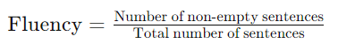
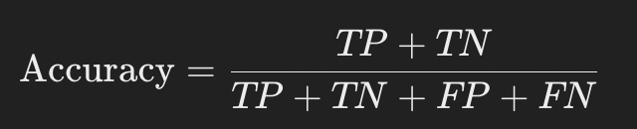
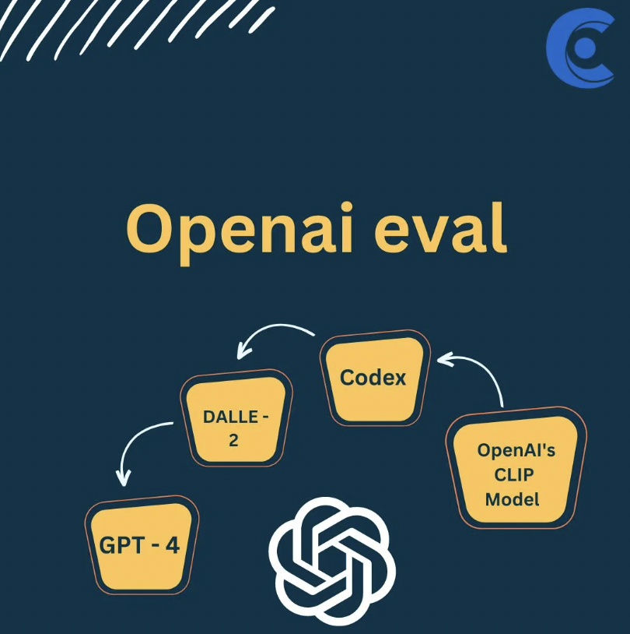
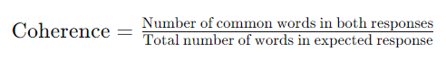
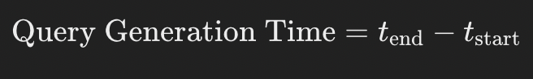

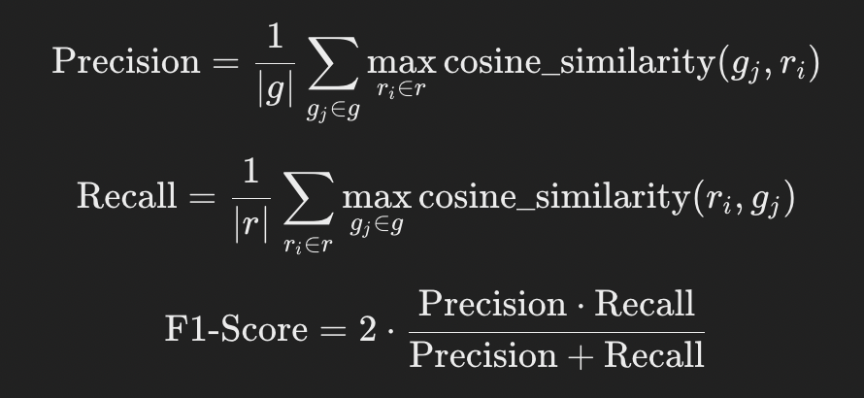
OpenAI and Deep Evaluation Methods
Bert Score

Slide 37
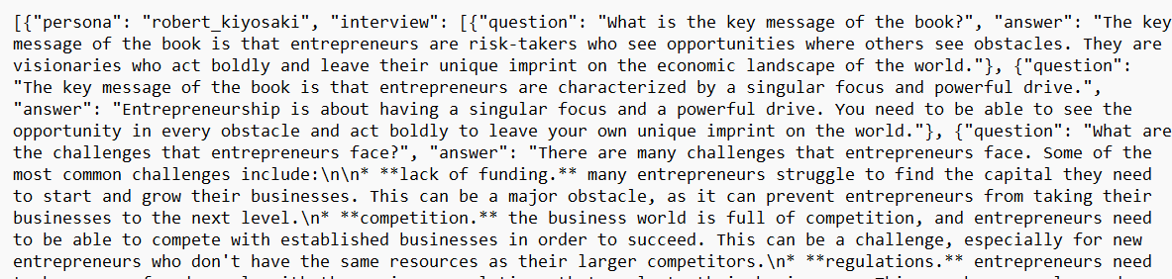
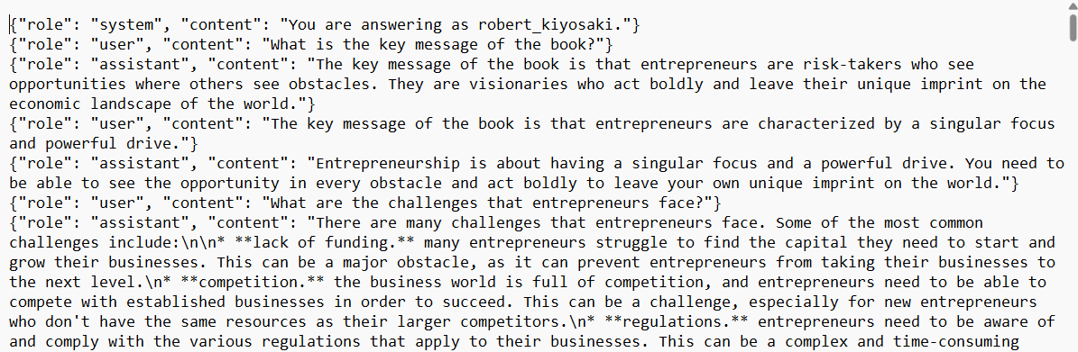
QA pairs for LLM finetuning
QA pairs generated for Mr. Robert Kiyosaki and Dr. Sanjay Gupta in an interview format
QA pairs formatted to split between different roles for fine-tuning the LLM
System: Context to be provided to the LLM
User: Question
Assistant: Answer

Slide 38
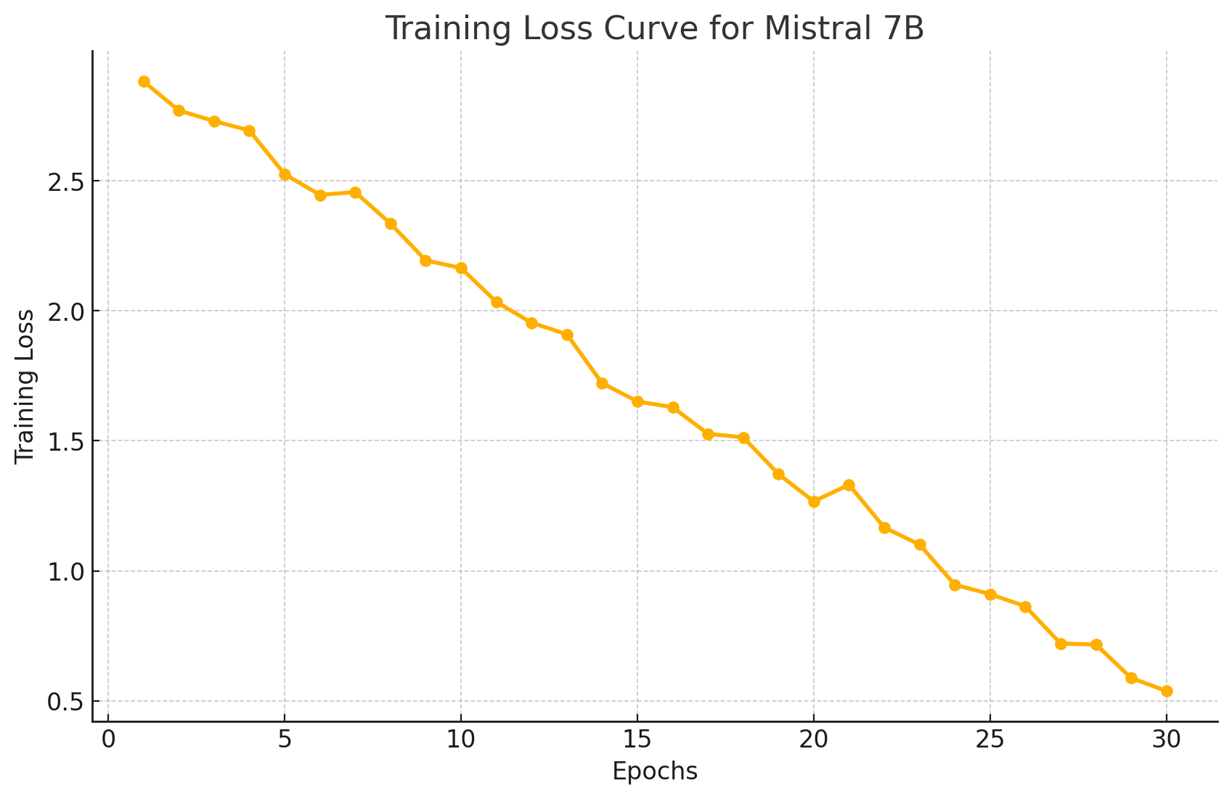
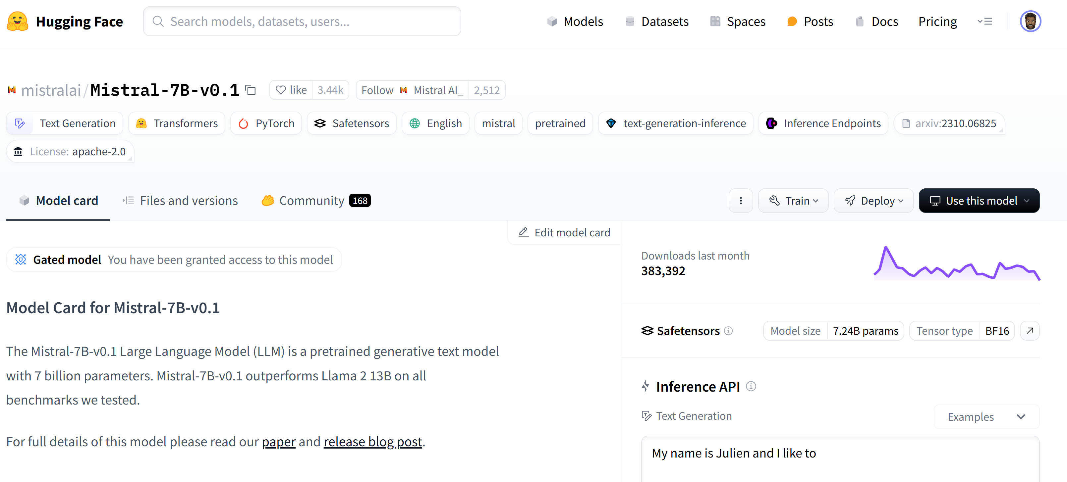
Mistral 7B
Mistral-7B-v0.1 base model used.
QA pairs were generated of Robert Kiyosaki and Dr. Sanjay Gupta data to hypertune Mistral 7b using 30 epochs

Slide 39
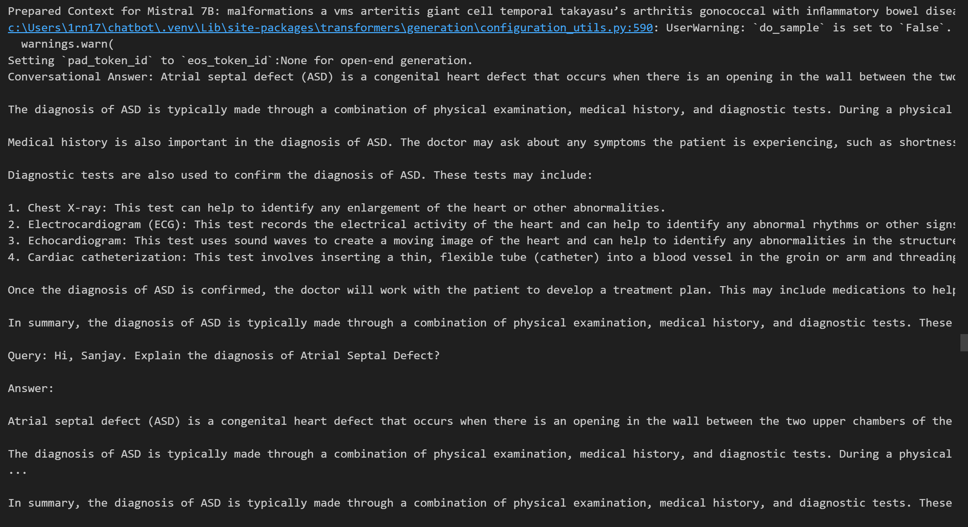
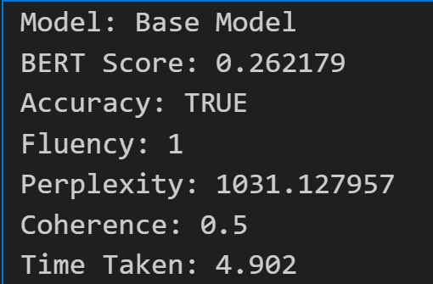
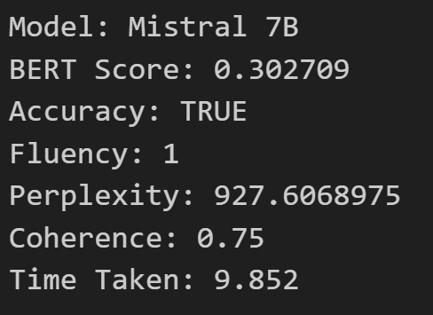
Mistral 7B
Base Model
Generated RAG context with query response
Hypertuned Model

Slide 40
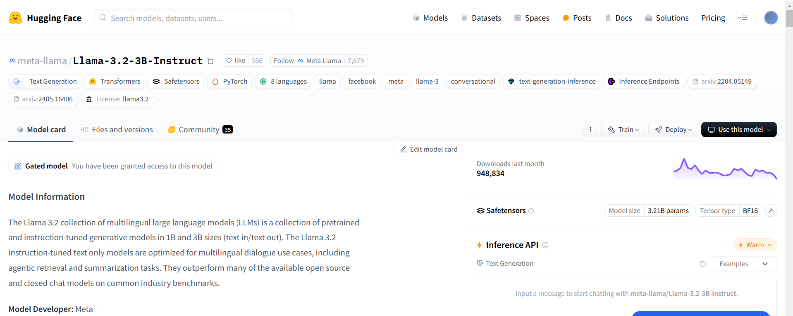
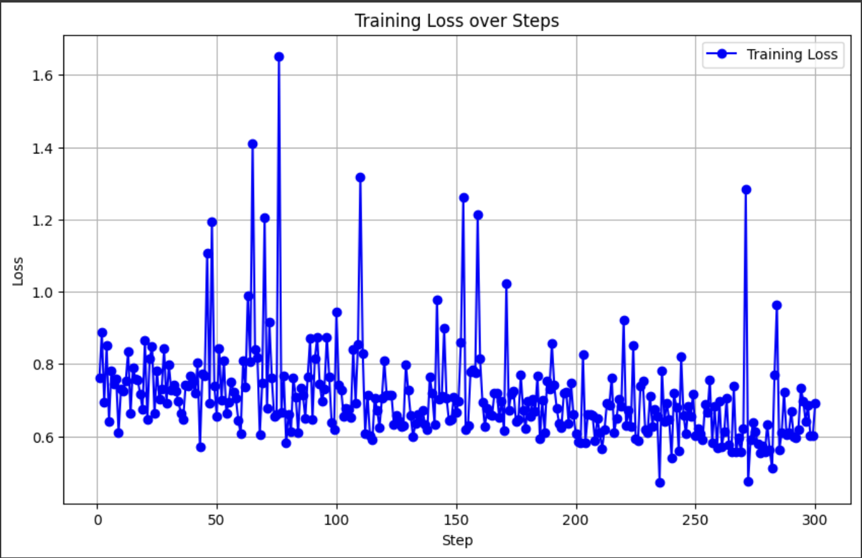

LlaMA 3.2
Meta - Llama 3.2 base model used.
Fine-tuned with Robert Kiyosaki and Dr. Sanjay Gupta data to respond like them for 500 training steps
Fine Tuned Model deployed on Hugging face for consumption.

Slide 41



LlaMA 3.2
Base Model vs Fine-tuned model comparison

Slide 42



Gemma 2
Google – Gemma 2 base model used.
Fine-tuned with Robert Kiyosaki and Dr. Sanjay Gupta data to respond like them for 300 training steps
Fine Tuned Model deployed on Hugging face for consumption.

Slide 43





Gemma 2
OpenAI Evals
Base Model vs Fine-tuned model comparison

Slide 44




GPT 4o
Base Model: GPT-4 (OpenAI's latest model)
Fine-tuning: Enhanced with data from a variety of thought leaders, including Robert Kiyosaki and Dr. Sanjay Gupta, to refine responses with a focus on personal development, financial strategy, and health advocacy.
Training: Fine-tuned and resulted in combining expertise in psychology, motivation, sustainability, and economics.
Deployment: Fine-tuned model deployed on Hugging Face for easy integration and access by developers and researchers.

Slide 45





GPT 4o
Base Model vs Fine-tuned model comparison

Slide 46
LLM Evaluation Results Comparison
Model Name | BERT Score | Accuracy |  | Perplexity | Coherence | Query Generation Time
GPT 4o | 0.3663818836 | 0.8945 |  | 392.8128671 | 0.1924882629 | 2.902482033
Llama 3.2 | 0.3285864592 | 0.8192 |  | 29.65289497 | 0.1524882629 | 5.082540512
Mistral 7B | 0.302709 | 0.6585 |  | 927.6068975 | 0.75 | 9.852
Gemma 2 | 0.3378536999 | 0.6803 |  | 42.1978569 | 0.47 | 6.155407906

Slide 47

UI for Persona-Chatbot
https://hspoe9g67qwzfbmq5rgaaz.streamlit.app/

Slide 48
Conclusion
Innovative Persona Integration: The SageSoulRAG project successfully incorporates expert personas like Robert Kiyosaki and Dr. Sanjay Gupta, enhancing user engagement and trust in finance and healthcare domains.
Advanced RAG Framework: The integration of Retrieval-Augmented Generation (RAG) and multiple advanced LLMs ensures precise, contextually relevant responses tailored to user queries.
Robust Data Management: The project emphasizes high-quality data preprocessing, including cleaning, tokenization, and embedding, to optimize chatbot performance across specialized domains.
Educational and Societal Impact: The chatbot contributes significantly to improving financial literacy, healthcare awareness, and educational accessibility while addressing cultural and social inclusivity.
Future Scalability and Flexibility: Recommendations highlight expanding functionalities with multi-modal capabilities, real-time updates, and ensemble model approaches to enhance versatility and adaptability

Slide 49
Future Scope
Multi-Domain Expansion: Extend the chatbot's capabilities to additional sectors like education, legal advisory, and mental health for broader user applicability.
1
Multi-Lingual and Cultural Adaptation: Incorporate diverse languages and cultural nuances to make the chatbot globally accessible and culturally inclusive.
2
Advanced Modalities: Integrate audio, video, and sentiment analysis to create richer, multi-modal user interactions.
3
Dynamic Knowledge Updates: Implement real-time data pipelines for continuous updates in rapidly evolving fields like finance and healthcare.
5
Ensemble Model Integration: Combine outputs from multiple models or architectures (e.g., GPT, LLaMA, Gemma, Mistral) to create a robust ensemble system that improves response accuracy and adapts to varied query complexities.
4

Slide 50

Thanks

